Slide 1
Android Overview

Slide 2
Objectives
At the end of this lesson, the student should able to:
Define what is android
Distinguish the different android API levels and categories
Classify the four main layers in the android architecture
Use the different android application components

Slide 3
What is Android?
Android is an open source and Linux-based Operating System for mobile devices such as smartphones and tablet computers. Android was developed by the Open Handset Alliance, led by Google, and other companies.
Android offers a unified approach to application development for mobile devices which means developers need only develop for Android, and their applications should be able to run on different devices powered by Android.

Slide 4
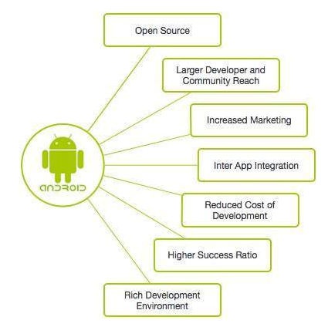
Why Android?

Slide 5
Features of Android
Beautiful UI - Android OS basic screen provides a beautiful and intuitive user interface.
Connectivity - GSM/EDGE, IDEN, CDMA, EV-DO, UMTS, Bluetooth, Wi-Fi, LTE, NFC and WiMAX.
Storage - SQLite, a lightweight relational database, is used for data storage purposes.
Media support - H.263, H.264, MPEG-4 SP, AMR, AMR-WB, AAC, HE-AAC, AAC 5.1, MP3, MIDI, Ogg Vorbis, WAV, JPEG, PNG, GIF, and BMP.
Messaging - SMS and MMS
Web browser - Based on the open-source WebKit layout engine, coupled with Chrome's V8 JavaScript engine supporting HTML5 and CSS3.
Multi-touch - Android has native support for multi-touch which was initially made available in handsets such as the HTC Hero.

Slide 6
Features of Android
Multi-tasking - User can jump from one task to another and same time various application can run simultaneously.
Resizable widgets - Widgets are resizable, so users can expand them to show more content or shrink them to save space.
Multi-Language - Supports single direction and bi-directional text.
GCM - Google Cloud Messaging (GCM) is a service that lets developers send short message data to their users on Android devices, without needing a proprietary sync solution.
Wi-Fi Direct - A technology that lets apps discover and pair directly, over a high-bandwidth peer-to-peer connection.
Android Beam - A popular NFC-based technology that lets users instantly share, just by touching two NFC-enabled phones together.

Slide 7
Android Applications
Android applications are usually developed in the Java language using the Android Software Development Kit.
Once developed, Android applications can be packaged easily and sold out either through a store such as Google Play, SlideME, Opera Mobile Store, Mobango, F-droid and the Amazon Appstore.

Slide 8
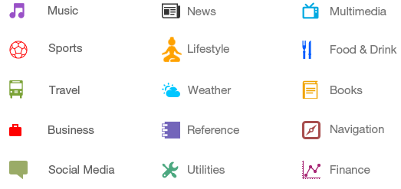
Categories of Android Applications
There are many android applications in the market. The top categories are:

Slide 9
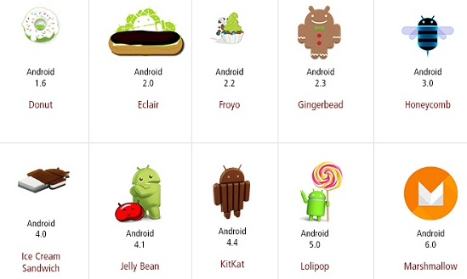
History of Android
The code names of android ranges from A to N currently, such as Aestro, Blender, Cupcake, Donut, Eclair, Froyo, Gingerbread, Honeycomb, Ice Cream Sandwitch, Jelly Bean, KitKat, Lollipop and Marshmallow. Let's understand the android history in a sequence.

Slide 10
What is API level?
API Level is an integer value that uniquely identifies the framework API revision offered by a version of the Android platform.
Platform Version | API Level | VERSION_CODE
Android 6.0 | 23 | MARSHMALLOW
Android 5.1 | 22 | LOLLIPOP_MR1
Android 5.0 | 21 | LOLLIPOP
Android 4.4W | 20 | KITKAT_WATCH | KitKat for Wearables Only

Slide 11
What is API level?
Platform Version | API Level | VERSION_CODE
Android 4.4 | 19 | KITKAT
Android 4.3 | 18 | JELLY_BEAN_MR2
Android 4.2, 4.2.2 | 17 | JELLY_BEAN_MR1
Android 4.1, 4.1.1 | 16 | JELLY_BEAN
Android 4.0.3, 4.0.4 | 15 | ICE_CREAM_SANDWICH_MR1
Android 4.0, 4.0.1, 4.0.2 | 14 | ICE_CREAM_SANDWICH
Android 3.2 | 13 | HONEYCOMB_MR2

Slide 12
What is API level?
Platform Version | API Level | VERSION_CODE
Android 3.1.x | 12 | HONEYCOMB_MR1
Android 3.0.x | 11 | HONEYCOMB
Android 2.3.4 Android 2.3.3 | 10 | GINGERBREAD_MR1
Android 2.3.2 Android 2.3.1 Android 2.3 | 9 | GINGERBREAD
Android 2.2.x | 8 | FROYO
Android 2.1.x | 7 | ECLAIR_MR1
Android 2.0.1 | 6 | ECLAIR_0_1
Android 2.0 | 5 | ECLAIR

Slide 13
What is API level?
Platform Version | API Level | VERSION_CODE
Android 1.6 | 4 | DONUT
Android 1.5 | 3 | CUPCAKE
Android 1.1 | 2 | BASE_1_1
Android 1.0 | 1 | BASE

Slide 14
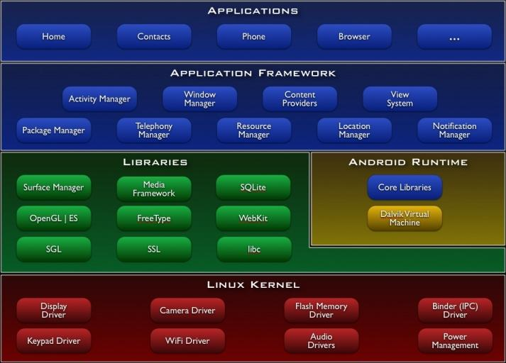
Android Architecture
Android operating system is a stack of software components which is roughly divided into five sections and four main layers as shown below in the architecture diagram.

Slide 15
Android Architecture

Slide 16
Linux Kernel layer
Android relies on Linux kernel
Supplies management of security, memory process, network, and drivers
Acts as an abstraction layer between the hardware and the rest of the Android software stack

Slide 17
Library layer
System C libraries and function Libraries, supporting multimedia, web browser, SQLite... Native Services to hardware
Android runtime
Dalvik Virtual Machine
Executes files in the Dalvik Executable (.dex) format
Java core Libraries
Provides most of the functionality of the Java programming language.
Java core libraries rely on the Dalvik VM and the underlying Linux kernel
Every Android application runs in its own process, with its own instance of the Dalvik virtual machine

Slide 18
Android Libraries
This category encompasses those Java-based libraries that are specific to Android development. Examples of libraries in this category include the application framework libraries in addition to those that facilitate user interface building, graphics drawing and database access. A summary of some key core Android libraries available to the Android developer is as follows −
android.app − Provides access to the application model and is the cornerstone of all Android applications.
android.content − Facilitates content access, publishing and messaging between applications and application components.
android.database − Used to access data published by content providers and includes SQLite database management classes.
android.opengl − A Java interface to the OpenGL ES 3D graphics rendering API.

Slide 19
Android Libraries
android.os − Provides applications with access to standard operating system services including messages, system services and inter-process communication.
android.text − Used to render and manipulate text on a device display.
android.view − The fundamental building blocks of application user interfaces.
android.widget − A rich collection of pre-built user interface components such as buttons, labels, list views, layout managers, radio buttons etc.
android.webkit − A set of classes intended to allow web-browsing capabilities to be built into applications.
Having covered the Java-based core libraries in the Android runtime, it is now time to turn our attention to the C/C++ based libraries contained in this layer of the Android software stack.

Slide 20
Application Framework layer
The Application Framework layer provides many higher-level services to applications in the form of Java classes. Application developers are allowed to make use of these services in their applications.

Slide 21
Application Framework layer
The Android framework includes the following key services −
Activity Manager − Controls all aspects of the application lifecycle and activity stack.
Content Providers − Allows applications to publish and share data with other applications.
Resource Manager − Provides access to non-code embedded resources such as strings, color settings and user interface layouts.
Notifications Manager − Allows applications to display alerts and notifications to the user.
View System − An extensible set of views used to create application user interfaces.

Slide 22
Application Layer
You will find all the Android application at the top layer. You will write your application to be installed on this layer only. Examples of such applications are Contacts Books, Browser, Games etc.

Slide 23
Application Components
Application components are the essential building blocks of an Android application. These components are loosely coupled by the application manifest file AndroidManifest.xml that describes each component of the application and how they interact.
These are the following four main components that can be used within an Android application:
Activities
Services
Broadcast Receivers
Content Providers

Slide 24
Activities
An activity represents a single screen with a user interface, in-short Activity performs actions on the screen. For example, an email application might have one activity that shows a list of new emails, another activity to compose an email, and another activity for reading emails. If an application has more than one activity, then one of them should be marked as the activity that is presented when the application is launched.
An activity is implemented as a subclass of Activity class as follows −
public class MainActivity extends Activity {
}

Slide 25
Services
A service is a component that runs in the background to perform long-running operations. For example, a service might play music in the background while the user is in a different application, or it might fetch data over the network without blocking user interaction with an activity.
A service is implemented as a subclass of Service class as follows −
public class MyService extends Service {
}

Slide 26
Broadcast Receivers
Broadcast Receivers simply respond to broadcast messages from other applications or from the system. For example, applications can also initiate broadcasts to let other applications know that some data has been downloaded to the device and is available for them to use, so this is broadcast receiver who will intercept this communication and will initiate appropriate action.
A service is implemented as a subclass of Service class as follows −
public class MyReceiver extends BroadcastReceiver {
public void onReceive(context,intent){}
}

Slide 27
Content Providers
A content provider component supplies data from one application to others on request. Such requests are handled by the methods of the ContentResolver class. The data may be stored in the file system, the database or somewhere else entirely.
A content provider is implemented as a subclass of ContentProvider class and must implement a standard set of APIs that enable other applications to perform transactions.
public class MyContentProvider extends ContentProvider {
public void onCreate(){}
}

Slide 28
Additional Components
There are additional components which will be used in the construction of above mentioned entities, their logic, and wiring between them. These components are −
Fragments Represents a portion of user interface in an Activity.
Views UI elements that are drawn on-screen including buttons, lists forms etc.
Layouts View hierarchies that control screen format and appearance of the views.
Intents Messages wiring components together.
Resources External elements, such as strings, constants and drawable pictures.
Manifest Configuration file for the application.

Slide 29
System level protection for android app
Each app runs as a unique user identity such that Android can limit the potential damage of programming flaws.
Each app runs in own VM sandbox using unique UID
Each app requests a simple permission label assignment model to restrict access to resources and other applications if necessary
Ex. of permission: Internet, camera, GPS
Permission specifies an access policy to protect its resources.

Slide 30
Android Permissions
All permission of Android’s policy are set at install time and can’t change until the application is reinstalled.
Android’s permission only restricts access to components and doesn’t currently provide information flow guarantees.
A permission is listed in app’s manifest definition XML file.
If a public component doesn’t explicitly declare any access permission, Android permits any application to access it.
Component A’s ability to access components B and C is determined by comparing the access permission labels on B and C to the collection of permission labels assigned to application A.

Slide 31
Android App Signature
All Android applications must be signed, but are usually self-signed
Why self signing?
Market ties identity to developer account
No CA in Google, Google does not have central control over the app’s signature certificates
No applications are trusted. No "magic key"
What does signing determine?
Author-update
In signature schemes, the private key is used to sign a app or message; anyone can check the signature using the public key.

Slide 32
Permissions on Android
App permissions help support user privacy by protecting access to the following:
Restricted data, such as system state and a user's contact information.
Restricted actions, such as connecting to a paired device and recording audio.

Slide 33
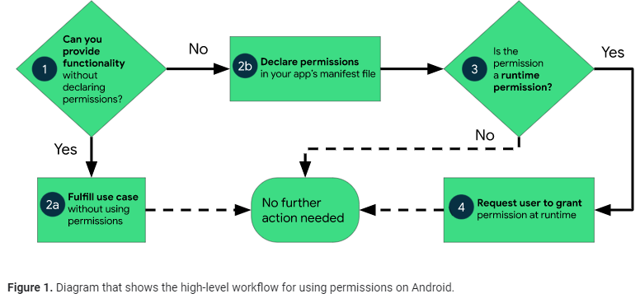
Figure 1 illustrates the workflow for using app permissions:

Slide 34
Types of permissions
Install-time permissions
Give your app limited access to restricted data, and they allow your app to perform restricted actions that minimally affect the system or other apps. When you declare install-time permissions in your app, the system automatically grants your app the permissions when the user installs your app. An app store presents an install-time permission notice to the user when they view an app's details page, as shown in Figure 2.

Slide 35
Types of permissions
Normal permissions
These permissions allow access to data and actions that extend beyond your app's sandbox. However, the data and actions present very little risk to the user's privacy, and the operation of other apps.

Slide 36
Types of permissions
Signature permissions
If the app declares a signature permission that another app has defined, and if the two apps are signed by the same certificate, then the system grants the permission to the first app at install time. Otherwise, that first app cannot be granted the permission.

Slide 37
Types of permissions
Runtime permissions
Runtime permissions, also known as dangerous permissions, give your app additional access to restricted data, and they allow your app to perform restricted actions that more substantially affect the system and other apps. Therefore, you need to request runtime permissions in your app before you can access the restricted data or perform restricted actions. When your app requests a runtime permission, the system presents a runtime permission prompt

Slide 38
Types of permissions
Special permissions
Special permissions correspond to particular app operations. Only the platform and OEMs can define special permissions. Additionally, the platform and OEMs usually define special permissions when they want to protect access to particularly powerful actions, such as drawing over other apps.
The Special app access page in system settings contains a set of user-toggleable operations. Many of these operations are implemented as special permissions.

Slide 39
Best practices
App permissions build upon system security features and help Android support the following goals related to user privacy:
Control: The user has control over the data that they share with apps.
Transparency: The user understands what data an app uses, and why the app accesses this data.
Data minimization: An app accesses and uses only the data that's required for a specific task or action that the user invokes.

Slide 40
References
1.http://www.businessweek.com/technology/content/oct2010/tc20101020_639668.htm
2. http://it-jobs.fins.com/Articles/SB129606993144879991/Mobile-App-Developers-Wanted-at-Ad-Agencies
3.http://www.gartner.com/it/page.jsp?id=1466313
4.http://developer.android.com/guide/developing/index.html
5.Android Overview, http://www.google.com/url?sa=t&rct=j&q=&esrc=s&source=web&cd=7&ved=0CEcQFjAG&url=http%3A%2F%2Fai.arizona.edu%2Fmis510%2Fslides%2FAndroid%2520Overview.ppt&ei=4HBXUNPvMuPe0QGm3oCYCg&usg=AFQjCNE2Li9vyh34rECKYDuOjKjI5pjyzw&sig2=E-wfIL1bPNJacCi6ZaAWCA
6. Tutorialspoint
https://www.tutorialspoint.com/android/android_hello_world_example.htm

